Slide 1
Chapter 1 Introduction and Basics of Distributed Computing

Slide 2
Distributed Computing
Distributed computing is the method of making multiple computers work together to solve a common problem.
It makes a computer network appear as a powerful single computer that provides large-scale resources to deal with complex challenges.
Distributed computing is one of the fundamental computing principles that drive the Blockchain technology.

Slide 3
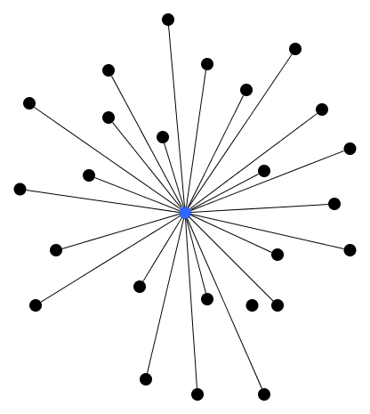
Centralized systems
Centralized systems are systems that use client/server architecture where one or more client nodes are directly connected to a central server.
Disadvantages of Centralized System
Highly dependent on the network connectivity – System can fail if the nodes lose connectivity as there is only one central node.
No graceful degradation of system – abrupt failure of the entire system
Less possibility of data backup - If the server node fails and there is no backup, you lose the data straight away
Difficult server maintenance – There is only one server node and due to availability reasons, it is inefficient and unprofessional to take the server down for maintenance. So, updates have to be done on-the-fly(hot updates) which is difficult and the system could break.

Slide 4
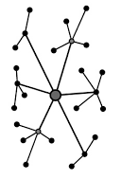
Decentralized systems
A decentralized system is an interconnected information system in which no single entity is the sole authority.
A decentralized system generally has multiple authoritative nodes, each of which serves a subset of the total end users.
Advantages of Decentralized System
Minimal problem of performance bottlenecks occurring – The entire load gets balanced on all the nodes; leading to minimal to no bottleneck situations
High availability – Some nodes are always available/online for work, leading to high availability
More autonomy and control over resources – As each node controls its own behavior, it has better autonomy leading to more control over resources.

Slide 5
Distributed Ledger Technology (DLT)
Distributed ledger technology (DLT) is the technological infrastructure and protocols that allow simultaneous access, validation, and record updating across a networked database.
DLT is the technology Blockchain are created from, and the infrastructure allows users to view any changes and who made them, reduces the need to audit data, ensures data is reliable, and only provides access to those that need it.

Slide 6
How Distributed Ledger Technology Works?
DLTs allow information to be stored securely and accurately using cryptography.
The data can be accessed using "keys" and cryptographic signatures.
Once the information is stored, it can become an immutable database; the rules of the network, written into the coding of the database programming, govern the ledger.
If something is immutable, it is unable to be changed. Distributed ledgers are only immutable if they are programmed to be that way. Blockchains are always immutable because they are decentralized public ledgers

Slide 7
Uses of Distributed Ledger Technology
Record transactions. DLT enables secure, transparent and decentralized transactions without the need for a central authority. As DLT is a ledger, it records inflows and outflows. Though this naturally lends itself to financial records, DLT can record any type of transaction even without financial undertones.
Secure identities. DLT can be used to create a secure and tamper-proof digital identity for individuals, as the technology can provide a reliable way to verify identities and prevent identity theft.
Collect votes. DLT can be used to create a secure and transparent voting system that can prevent voter fraud and ensure the integrity of the voting process. As mentioned above, as transactions (financial or non-financial) are recorded, a transparent, immutable, open ledger of interactions with users is saved. This enhances the equity and believability of a collection of opinions.
Enter contracts. DLT allows for smart contracts, agreements that automatically execute or complete based on prevailing conditions. For example, an insurance claim may automatically release funds once the claim has been processed. This limits error, and DLTs make it more difficult for precarious activity by bad actors.
Demonstrate ownership. DLT can be used to record property transactions, creating a tamper-proof and transparent record of ownership and transfer of property. Though there are some limitations on translating real-world ownership of physical assets to a distributed ledger, the ledger may be able to convey an unchangeable source of truth regarding ownership.

Slide 8
Pros and Cons of DLT
Pros | Cons
Spreads systematic risk around, minimizing the risk of a single point of failure | Is more complex compared to traditional ledger solutions
Has greater security due to cryptographic algorithms | Often requires higher energy consumption for operation
Allows for transparency and visibility into operations | May have difficult scaling as more users/transactions occur
May prove to be more efficient due to smart contract automation | Still remains risky due to lack of regulation
Offers individuals with limited access to traditional systems potentially greater capabilities | May prove to be difficult to reverse fraudulent or erroneous activity

Slide 9
Need for Distributed Record Keeping
Distributed record-keeping, often facilitated by technologies like blockchain, is valuable for several reasons:
Immutability: Distributed record-keeping systems create a tamper-resistant ledger where once data is added, it becomes extremely difficult to alter or delete. This immutability is crucial for maintaining the integrity of historical records and preventing fraud.
Decentralization: Distributed systems do not rely on a single central authority or intermediary. This reduces the risk of a single point of failure, censorship, or manipulation by a central entity. Instead, data is stored across a network of nodes, making it more resilient.
Transparency: Transactions and data on distributed ledgers are typically visible to all participants in the network. This transparency enhances trust among users, as they can independently verify the accuracy and legitimacy of the records.
Security: Distributed record-keeping often employs strong cryptographic techniques to secure data. This enhances the security and privacy of sensitive information, making it difficult for unauthorized parties to access or manipulate data.
Efficiency: Smart contracts and automation on distributed networks can streamline record-keeping processes, reducing the need for manual intervention and intermediaries. This can lead to faster, more efficient transactions and reduced operational costs.
Global Accessibility: Distributed record-keeping systems are accessible from anywhere with an internet connection. This global accessibility is especially valuable for businesses and individuals operating across borders.
Trustless Transactions: In many cases, distributed record-keeping systems enable trustless transactions, meaning parties can engage in transactions without needing to trust each other explicitly. The trust is established through the underlying technology and consensus mechanisms.
Auditability: Every transaction and change to the ledger is recorded, creating a comprehensive audit trail. This is valuable for compliance, accountability, and dispute resolution.
Innovation: Distributed record-keeping has spurred innovation in various fields, including finance (cryptocurrencies), supply chain management, voting systems, and more. It provides a foundation for new ways of conducting business and managing data.
Resilience: Distributed systems are inherently resilient to network disruptions, as the data is redundantly stored across multiple nodes. This resilience is critical in scenarios where uninterrupted access to records is essential.
Overall, the need for distributed record-keeping arises from the desire for increased trust, security, transparency, and efficiency in various applications, from financial transactions to supply chain management and beyond.

Slide 10

Blockchain Overview
Blockchain is a shared, immutable ledger that facilitates the process of recording transactions and tracking assets in a business network.
An asset can be tangible (a house, car, cash, land) or intangible (intellectual property, patents, copyrights, branding).
Virtually anything of value can be tracked and traded on a Blockchain network, reducing risk and cutting costs for all involved.
Blockchain, sometimes referred to as distributed ledger technology (DLT).

Slide 11
Analogy of Blockchain Technology
A simple analogy for how Blockchain technology operates can be compared to how a Google Docs document works.
When you create a Google Doc and share it with a group of people, the document is simply distributed instead of copied or transferred.
This creates a decentralized distribution chain that gives everyone access to the base document at the same time.
No one is locked out awaiting changes from another party, while all modifications to the document are being recorded in real-time, making changes completely transparent.
A significant gap to note however is that unlike Google Docs, original content and data on the Blockchain cannot be modified once written, adding to its level of security.
Of course, Blockchain is more complicated than a Google Doc, but the analogy is apt because it illustrates critical ideas of the technology.

Slide 12
Why Blockchain is important?
Business runs on information.
The faster it’s received and the more accurate it is, the better.
Blockchain is ideal for delivering that information because it provides immediate, shared and completely transparent information stored on an immutable ledger that can be accessed only by permissioned network members.
A Blockchain network can track orders, payments, accounts, production and much more.
And because members share a single view of the truth, you can see all details of a transaction end to end, giving you greater confidence, as well as new efficiencies and opportunities.

Slide 13
Blockchain Vs Database
Parameters | Blockchain Architecture | Database
Control | Blockchain is decentralized because there is no single point of failure and there is no central authority to control the Blockchain. | The database is Centralized.
Operations | Blockchain has only an Insert operation. | The database has Create, Read, Update, and Delete operations.
Strength | It is robust technology. | The database is not fully robust technology.
Mutability | Blockchain is immutable technology and we cannot change it back or we cannot go back. | The database is a fully mutable technology, The data can be edited in the database.
Rights | Anyone with the right proof of work can write on the blockchain. | In the database reading and writing can do so.
Speed | It is slow in speed. | It is faster as compared to Blockchain.

Slide 14
Byzantine Generals Problem
The Byzantine Generals Problem is a classic problem in distributed computing and computer science that illustrates the challenges of achieving consensus in a network of nodes (generals) when some of the nodes may be faulty or malicious.
The problem was first introduced by Leslie Lamport, Robert Shostak, and Marshall Pease in a 1982 paper titled "The Byzantine Generals Problem.“
In this scenario, a group of Byzantine generals surround a city they intend to attack or retreat from.
The generals must reach a consensus on whether to attack or retreat, but some of the generals might be traitors who send conflicting messages to confuse the loyal generals.
The loyal generals need to agree on a common decision despite the possibility of receiving contradictory messages from the traitorous generals.

Slide 15
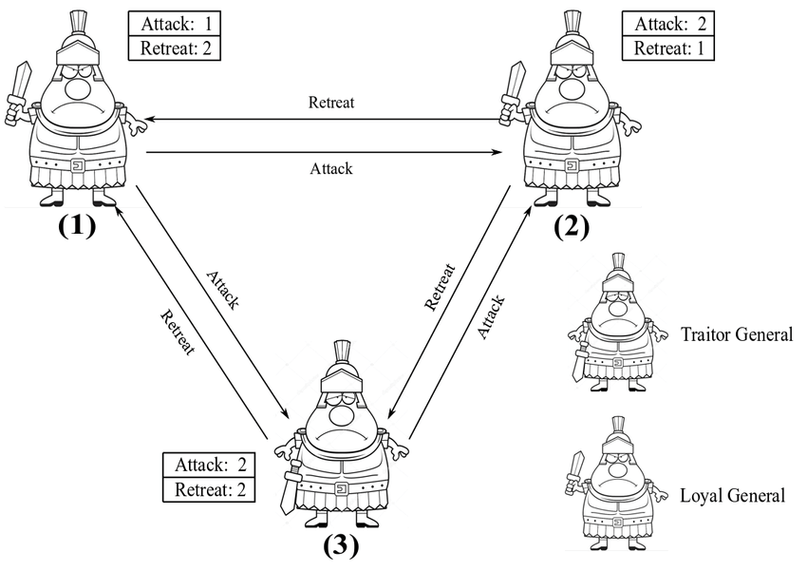
Key challenges of the Byzantine Generals Problem
Traitorous Generals: The problem assumes that some generals might be traitors who will try to disrupt the consensus process by sending inconsistent messages to different generals.
Asynchronous Communication: Generals can only communicate by sending messages to each other, and there is no guarantee about the timing of message delivery or the order in which they will be received.
Uncertain Information: Loyal generals need to decide on the majority course of action based on the received messages, but they cannot be certain which generals are traitors and which are loyal. This uncertainty complicates the decision-making process.
Solving the Byzantine Generals Problem involves designing algorithms and protocols that allow the loyal generals to agree on a common decision, even in the presence of faulty or malicious nodes. There are different variations of the problem, such as the "Byzantine Fault Tolerance" (BFT) protocols, which aim to provide robust consensus mechanisms in distributed systems.
Practical Byzantine Fault Tolerance" (PBFT) algorithm, proposed by Castro and Liskov in 1999 is designed to provide consensus even when up to one-third of the nodes are faulty or malicious.

Slide 16
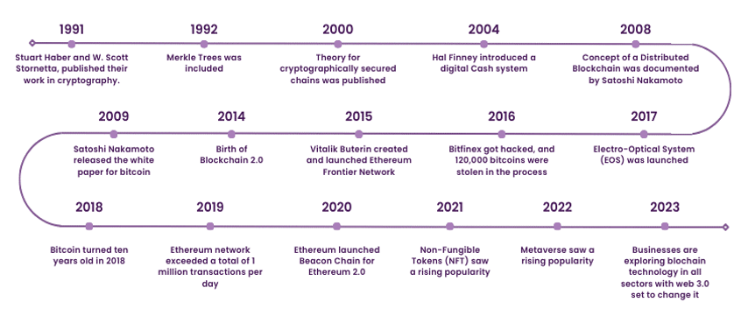
History of Blockchain
Refer Notes Section Below for a Detailed Description.
Notes:
1991
In 1991, two scientists, Stuart Haber and W. Scott Stornetta, published their work in cryptography. Their work included a chain of blocks secured using cryptography so the content and its date couldn't be tampered with. This system later became known as Blockchain Technology, referring to the chain of blocks, where each block stored vital information.
1992
The system was further upgraded in 1992 when Merkle Trees was included to make it more efficient. This made adding multiple documents on one block in a Blockchain possible. Unfortunately, this technology reached a cease in 2004 due to a patent.
2000
Stefan Konst published his theory for cryptographically secured chains and their implementation in 2000.
Refer to these Blockchain Interview Questions and Answers to crack your next job interview!
2004
Hal Finney introduced a digital Cash system in 2004. This system was referred to as Reusable proof of work, and it solved the critical issue of double spending by registering token ownership.
2008
Satoshi Nakamoto modified Merkle Tree’s model in 2008, leading to a more secure system containing a data exchange history. This concept of a Distributed Blockchain was documented in his white paper “a peer-to-peer electronic cash system”. This peer-to-peer network of time stamps led to Blockchain becoming the backbone of cryptography.
2009
This was an important year in Blockchain history as Satoshi Nakamoto released the white paper for Bitcoin in 2009. Blockchain reached a new peak of security at this stage, as documented by an event in the UK in 2013.
James Howells, an IT worker in the UK, started mining bitcoins in 2009, spending over 14000 GBP until 2013. Once he was done Mining Bitcoins, he extracted his drive and sold the remaining parts of his laptop. Unfortunately, he tossed his hard drive away with garbage while cleaning his room in 2013. A few years passed, and while he could not claim his Bitcoins, which rose to a value of more than 105 million GBP by 2017, no one else could claim that money.
2014
Blockchain Technology was separated from currency, leading to the birth of Blockchain 2.0 in 2014. This changed the focus of industries away from digital currency and its trajectory to the development of Blockchain technologies.
2015
Vitalik Buterin created and launched the Ethereum Frontier Network with its other co-founders in 2015. Ethereum was another open-source Blockchain, which later reached the second highest market capitalisation, second only to Bitcoin. Ethereum came with smart contract functionality and the ability to deploy decentralised applications, allowing users to interact with them.
The Linux Foundation launched the Hyperledger project in the same year, where it started working on an open-source Blockchain. It was developed as an umbrella project, facilitating the collaborative development of distributed ledgers. Its fundamental goal is to enhance performance to help in global transactions.
2016
Blockchain was finally referred to as a single term rather than two different entities, moving further from how it was described in Satoshi Nakamoto's original white paper on Blockchain.
In 2016, when Blockchain started seeing the face of mainstream popularity, the Decentralised Autonomous Organisation of Ethereum (DAO Ethereum) had its code exploited. This led to a difference in the principles of its stockholders, leading to a hard fork in Ethereum. Simultaneously a Cryptocurrency exchange service known as Bitfinex was hacked, and 120,000 bitcoins were stolen in the process.
2017
Japan recognised Bitcoin as a legal form of payment method in 2017. In the same year, Block. One, a private company, launched an Electro-Optical System (EOS) as a native Cryptocurrency. EOS.IO has been used as a decentralised operating system and facilitates the deployment of decentralised apps via autonomous decentralised corp.
2018
Bitcoin turned ten years old in 2018, marking its success; however, what followed was not as celebratory for Bitcoin. Online platforms soon started banning Cryptocurrency advertisements, with Google, Facebook, and Twitter following suit. At the end of 2018, Bitcoin’s value reached a significant low of 3157.23 GBP.
Want to know more about cryptocurrencies? Sign up for our Bitcoin And Cryptocurrency course!
2019
The Ethereum network exceeded 1 million transactions per day in 2019. Soon, Amazon announced an Amazon Managed Blockchain service on its Amazon Web Services (AWS) Platform.
2020
Ethereum launched Beacon Chain in 2020 in preparation for Ethereum 2.0. Stablecoins, which are more stable than traditional cryptocurrencies, also saw a rising popularity this year.
2021
2021 can be considered the most eventful year for Blockchain Technology which, includes the impact of the COVID-19 pandemic. Here's a roadmap of how this year unfolded in the realm of Blockchain and digital assets:
1) Q1: Rise of NFTs
1) January - March
a) NFTs gain significant traction, becoming a popular form of digital assets.
b) Artists and traders embrace NFT marketplaces like OpenSea for trading digital art, videos, and music records.
c) The surge in NFT popularity boosts the digital assets market.
2) Q2: Virtual World and Metaverse Creation
2) April - June
a) The pandemic-driven remote work culture continues to evolve.
b) Increased interest in Virtual Reality (VR) and Augmented Reality (AR) technologies.
c) Integration of VR, AR, and Web3 technologies leads to the conceptualisation of the Metaverse.
d) Mark Zuckerberg announces Facebook’s rebranding to Meta, reflecting a focus on building the Metaverse.
3) Q3: Bitcoin's Highs and Lows
3) July - September
a) Bitcoin reaches an all-time high value of £53,884.68.
b) Elon Musk endorses Bitcoin as a payment method for Tesla vehicles.
c) Musk later retracted this endorsement due to environmental concerns related to Bitcoin mining.
4) Q4: Global Reactions to Cryptocurrency
4) October - December
a) El Salvador becomes the first country to adopt Bitcoin as legal tender.
b) India bans the use of Cryptocurrencies as a payment method.
c) Despite varied national responses, Web3 technology sees widespread promotion and adoption globally.
2022
The year 2022 carried the previous popularity of NFTs, leading to more excellent opportunities for trading and earning with NFTs. It was further endorsed on the Metaverse by several corporate giants like Adidas, Puma, Nike, Walmart, Gucci and Ferrari. These companies created and promoted NFT designs based on their products for avatars on Metaverse.
However, NFTs were not taken positively everywhere, with India taxing digital assets at 30%. Blockchain and its uses continue to be explored and tested in various fields, such as Blockchain in the Supply Chain, satellite communication using Smart Contracts, entertainment, automation, and real estate.
2023
Despite the recent setbacks for Cryptocurrency, businesses continue to explore Blockchain Technology with increased vigilance. While it has traditionally found applications in finance and banking, the scope extends far beyond. Think gaming, media, real estate, healthcare, cybersecurity, Smart Contracts, NFTs, IoT, transportation, supply chain management, and even government services.
However, the real game-changer might just be Web 3.0—an internet iteration that promises decentralisation and robust data security, propelling Blockchain Technology to new heights!

Slide 17
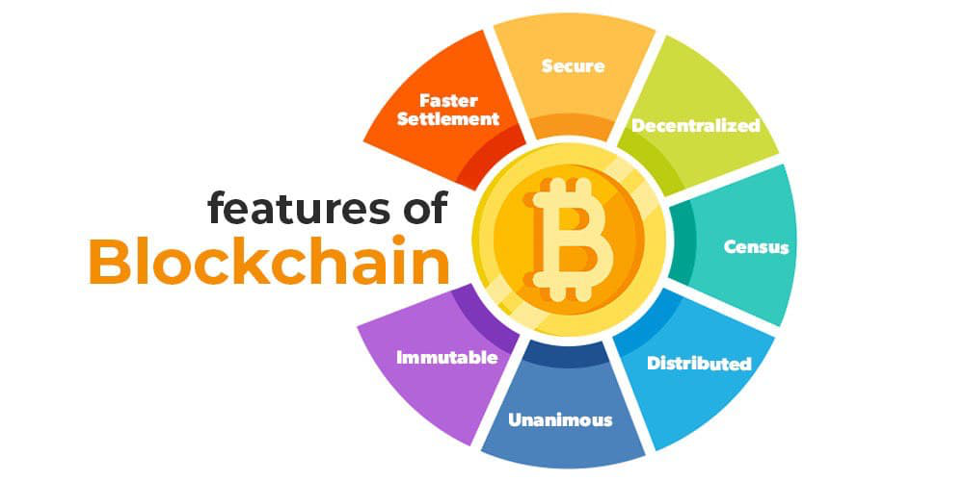
Features of Blockchain
Refer Notes Section Below for a Detailed Description.
Notes:
1. Immutable
Immutability means that the blockchain is a permanent and unalterable network. Blockchain technology functions through a collection of nodes. Once a transaction is recorded on the blockchain, it cannot be modified or deleted. This makes the blockchain an immutable and tamper-proof ledger that provides a high degree of security and trust.
Every node in the network has a copy of the digital ledger. To add a transaction every node checks the validity of the transaction and if the majority of the nodes think that it is a valid transaction then it is added to the network. This means that without the approval of a majority of nodes no one can add any transaction blocks to the ledger.
Any validated records are irreversible and cannot be changed. This means that any user on the network won’t be able to edit, change or delete it.
2. Distributed
All network participants have a copy of the ledger for complete transparency. A public ledger will provide complete information about all the participants on the network and transactions. The distributed computational power across the computers ensures a better outcome.
Distributed ledger is one of the important features of blockchains due to many reasons like:
In distributed ledger tracking what’s happening in the ledger is easy as changes propagate really fast in a distributed ledger.
Every node on the blockchain network must maintain the ledger and participate in the validation.
Any change in the ledger will be updated in seconds or minutes and due to no involvement of intermediaries in the blockchain, the validation for the change will be done quickly.
If a user wants to add a new block then other participating nodes have to verify the transaction. For a new block to be added to the blockchain network it must be approved by a majority of the nodes on the network.
In a blockchain network, no node will get any sort of special treatment or favors from the network. Everyone will have to follow the standard procedure to add a new block to the network.
3. Decentralized
Blockchain technology is a decentralized system, which means that there is no central authority controlling the network. Instead, the network is made up of a large number of nodes that work together to verify and validate transactions. Each and every node in the blockchain network will have the same copy of the ledger.
Decentralization property offers many advantages in the blockchain network:
As a blockchain network does not depend on human calculations it is fully organized and fault-tolerant.
The blockchain network is less prone to failure due to the decentralized nature of the network. Attacking the system is more expensive for the hackers hence it is less likely to fail.
There is no third-party involved hence no added risk in the system.
The decentralized nature of blockchain facilitates creating a transparent profile for every participant on the network. Thus, every change is traceable, and more concreate.
Users now have control over their properties and they don’t have to rely on third-party to maintain and manage their assets.
4. Secure
All the records in the blockchain are individually encrypted. Using encryption adds another layer of security to the entire process on the blockchain network. Since there is no central authority, it does not mean that one can simply add, update or delete data on the network. Every information on the blockchain is hashed cryptographically which means that every piece of data has a unique identity on the network. All the blocks contain a unique hash of their own and the hash of the previous block. Due to this property, the blocks are cryptographically linked with each other. Any attempt to modify the data means to change all the hash IDs which is quite impossible.
5. Consensus
Every blockchain has a consensus to help the network to make quick and unbiased decisions. Consensus is a decision-making algorithm for the group of nodes active on the network to reach an agreement quickly and faster and for the smooth functioning of the system. Nodes might not trust each other but they can trust the algorithm that runs at the core of the network to make decisions. There are many consensus algorithms available each with its pros and cons. Every blockchain must have a consensus algorithm otherwise it will lose its value.
6. Unanimous
All the network participants agree to the validity of the records before they can be added to the network. When a node wants to add a block to the network then it must get majority voting otherwise the block cannot be added to the network. A node cannot simply add, update, or delete information from the network. Every record is updated simultaneously and the updations propagate quickly in the network. So it is not possible to make any change without consent from the majority of nodes in the network.
7. Faster Settlement
Traditional banking systems are prone to many reasons for fallout like taking days to process a transaction after finalizing all settlements, which can be corrupted easily. On the other hand, blockchain offers a faster settlement compared to traditional banking systems. This blockchain feature helps make life easier.
Blockchain technology is increasing and improving day by day and has a really bright future in the upcoming years. The transparency, trust, and temper proof characteristics have led to many applications of it like bitcoin, Ethereum, etc. It is a pillar in making the business and governmental procedures more secure, efficient, and effective.
More Features of Blockchain
Smart Contracts – Blockchain technology enables the creation and execution of smart contracts, which are self-executing contracts that automatically execute when certain conditions are met. Smart contracts have the potential to revolutionize various industries by providing a secure and transparent way to execute contracts.
Transparency – The blockchain ledger is public and transparent, which means that anyone can access and view the transactions on the network. This makes it a highly transparent system that is resistant to fraud and corruption.
Applications of Blockchain – Blockchain technology has a wide range of applications across various industries. Some of the most well-known applications include cryptocurrency, supply chain management, identity verification, and voting systems. However, blockchain technology has the potential to revolutionize many other industries as well, such as healthcare, real estate, and finance.
Conclusion: In conclusion, blockchain technology is a revolutionary technology that has the potential to transform various industries. Its decentralized, secure, transparent, and immutable nature make it a highly desirable platform for various applications. As the technology continues to evolve and mature, we can expect to see more innovative use cases for blockchain technology in the future.

Slide 18
Important Blockchain terminologies (1/4)
Node : A member of the Blockchain network.
Address : An address is a string of alphanumeric characters which identify an entity in the Blockchain network. Used to send and receive cryptocurrency transactions.
Distributed ledger : A ledger which is maintained on many nodes in a decentralized network. The records are stored in a chronological order. This ledger can be of two types : Permissioned and Unpermissioned based on who has the access to view the ledger.
Peer to peer : Also short termed as P2P. As the name suggests, interactions that happen between two peers(parties/entities) in a highly interconnected network.
Block : A block is a data structure that contains all the necessary metadata about the block(Block Header) itself and contains transactions. The first block in a Blockchain is called the genesis block.
Block height : Block height is the number of blocks connected in the Blockchain. Block height is a usually measure of the amount of data in the Blockchain.
Blockchain : A chain of blocks which contain some metadata about the block, some transactions and joined to the previous block by the previous block’s hash value.
Block explorer : A tool to see statistics of a block in a Blockchain.
Hash : Performing a hash function on the data in a Blockchain is termed as hash. Commonly used in sentences like the hash of “hello” file is 2cf24dba5fb0a30e26e83b2ac5b9e29e1b161e5c1fa7425e73043362938b9824”. Used in verifying cryptocurrency transactions. Blockchain uses SHA256 algorithm. https://xorbin.com/tools/sha256-hash-calculator
Hash rate: Performance of a computer mining is measured in hashes per second or hash rate.
Cryptographic hash function : A function that takes a variable-size input and output is a fixed-size unique value. SHA-256 algorithm is a cryptographic hash function example.
Mining : Process of solving a complex mathematical problem in order to attach the new block of transactions to the Blockchain. This term is used in reference to Blockchain that use Proof-of-Work as consensus mechanism. But general use of this term is prevalent too.
Difficulty : Hardness with which a new block of transactions can be connected to the Blockchain. In Bitcoin, the difficulty is adjusted every 2016 blocks to keep the time of mining a new block at about 10 minutes.

Slide 19
Important Blockchain terminologies (2/4)
Block reward : Reward that is given to the entity which connects the new block to the Blockchain. In the case of Bitcoin, miners get a reward of 12.5 Bitcoins for attaching new block to the Blockchain. In the case of Peercoin, minters get a reward of 42.64 (at the time of writing this article) Peercoins for attaching a new block of transactions to the Blockchain.
Cryptocurrency : A format of digital asset which is regulated and transacted on the Blockchain network. Encryption techniques are used to regulate the cryptocurrency, hence the name.
Satoshi : The smallest recordable unit of currency in the Bitcoin. Currently, a satoshi is numerically equal to 0.00000001 BTC.
Altcoin : An alternative to Bitcoin (ALTernative COIN). A famous altcoin is Litecoin.
Wallet : A wallet is a file that contains the private keys of an entity. A wallet provides an interface to view and do transactions on the Blockchain. Different wallets for different type of Blockchain.

Slide 20
Important Blockchain terminologies (3/4)
Consensus: Consensus is a way for all the nodes in a network to agree on the shared state of the ledger (list of transactions). Some common consensus mechanisms are Raft, Paxos, Byzantine Fault Tolerance algorithm, Proof-of-Work(PoW), Proof-of-Stake (PoS), etc.
Smart contract: A smart contract has details and permissions written in code that require an exact sequence of events to take place to trigger the agreement of the terms mentioned in the smart contract. It can also include the time constraints that can introduce deadlines in the contract. Also known as cryptocontract and digital contract. It was first put forward by Nick Szabo in 1994.
Transaction: An exchange of assets between two parties/entities.
Transaction Fee: A part of the digital asset (cryptocurrency) that is charged from the parties who perform that transaction as a way to pay the networks who invest their resources in order to sustain the Blockchain. In a proof of stake based Blockchain (like Peercoin). the transaction fee is transferred to the minter/forger once he validates the new block of transactions successfully.

Slide 21
Important Blockchain terminologies (4/4)
Blockchain fork: An act of Blockchain software update which leads to splitting of a Blockchain into two or more valid blockchains. There are three common types of forks in Blockchain, namely, hard fork, soft fork, temporary/accidental fork.
51% attack: An attack in which a single organization (of entities) performs invalid activities on the Blockchain network because they control 51% of the network’s resources. In the Bitcoin network, it refers to owning 51% of miners. In Peercoin, it refers to owning 51% of peercoins.
Double Spend: An act of using the same digital asset (cryptocurrency) twice. Its a common type of attack in blockchains. This type of attack becomes more difficult with increasing members that add the new block to the chain.
Confirmation: The confirmation is the act of successfully adding a transaction to the Blockchain after verification. As a rule of thumb, more confirmations means more security against a double spend attack (permanency).
Testnet: As the name suggests, a Bitcoin test Blockchain which is used by the network developers to carry out tests so that the main Blockchain network is not affected. Assets in a testnet do not have any value. There have been three generations of testnet at the time of writing this article i.e., Testnet1, Testnet2, Testnet3 (currently).
dApp: Full form : decentralized Application. An application that is open sourced which is operated anonymously and has its data stored on a Blockchain. It must have some kind of incentive for the members who help to construct the Blockchain.
ASIC : Full form : Application Specific Integrated Circuit. These are a type of computers which are designed for performing a special task. In the case of Bitcoin, ASIC computers are used to solve SHA-256 hashing problem which help to connect the new blocks to the Blockchain.

Slide 22
Core Components of Blockchain Architecture
Node: Nodes are network participants and their devices permit them to keep track of the distributed ledger and serve as communication hubs in various network tasks. A block broadcasts all the network nodes when a miner looks to add a new block in transactions to the Blockchain.
Transactions: A transaction refers to a contract or agreement and transfers of assets between parties. The asset is typically cash or property. The network of computers in Blockchain stores the transactional data as copy with the storage typically referred to as a digital ledger.
Block: A block in a Blockchain network is similar to a link in a chain. In the field of cryptocurrency, blocks are like records that store transactions like a record book, and those are encrypted into a hash tree. There are a huge number of transactions occurring every day in the world. It is important for the users to keep track of those transactions, and they do it with the help of a block structure. The block structure of the Blockchain is mentioned in the very first diagram in this article.
Chain: Chain is the concept where all the blocks are connected with the help of a chain in the whole Blockchain structure in the world. And those blocks are connected with the help of the previous block hash and it indicates a chaining structure.
Miners: Blockchain mining is a process that validates every step in the transactions while operating all cryptocurrencies. People involved in this mining they called miners. Blockchain mining is a process to validate each step in the transactions while operating cryptocurrencies.
Consensus: A consensus is a fault-tolerant mechanism that is used in computer and Blockchain systems to achieve the necessary agreement on a single state of the network among distributed processes or multi-agent systems, such as with cryptocurrencies. It is useful in record keeping and other things.

Slide 23
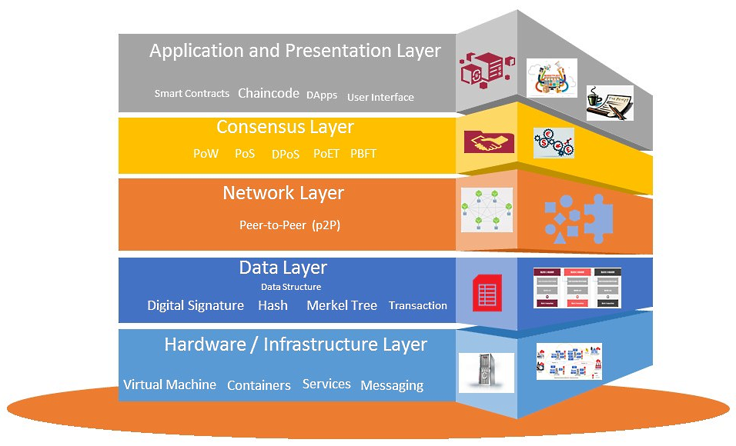
Layered structure of the Blockchain architecture
Refer Notes Section Below for a Detailed Description.
Notes:
The 5 Blockchain 7ayers are explained below:
1. Hardware or Infrastructure Layer
Hardware or infrastructure makes up the Blockchain’s top layer. On a server housed in a data center, the content for the Blockchain is hosted.
Client-server architecture, as used in web browsing and other applications, refers to the process where clients request data or content from application servers.
Blockchain technology typically uses a Peer-to-Peer (P2P) network of computers to calculate, validate, and record transactions in an ordered format in a shared ledger.
A distributed database is the end result, and it keeps track of all the data, transactions, and other pertinent information.
Nodes are the computers that make up a peer-to-peer network. The Blockchain network’s nodes are responsible for verifying transactions, grouping them into blocks, broadcasting them to the network, and so forth.
In the event that all parties agree, the nodes update their local copies of the ledger and commit the block to the Blockchain network. A device is referred to and utilized as a node after it connects to a blockchain network.
2. Data Layer
The linked list used to represent a blockchain’s data structures has two main components: pointers and a linked list of blocks that arrange the transactions.
A linked list is a collection of chained blocks where each block is filled with data and pointers to the block before it. Pointers are variables that refer to the location of other variables.
A Merkle tree is a binary tree of hashes that holds the hash of the Merkle root along with other information including the hash of the previous block, the date, the nonce, the block version number, and the current difficulty goal.
Blockchain technology is secured, has integrity, and is irrefutable due to a Merkle tree.
A hash tree, also known as a Merkle tree, is a tree in which each leaf node is labeled with the cryptographic hash of a data block and each non-leaf node is labeled with the labels of all of its child nodes.
In order to guarantee the security and integrity of the data stored there, transactions are digitally signed on the blockchain.
Anybody with the public key can validate the signer of a transaction that has been signed using a private key.
Because the encrypted data is also signed, the digital signature ensures data integrity and verifies information tampering.
Data encryption prevents the detection of the information. The sender’s or owner’s identity is also protected by a digital signature.
The structure of a block on a blockchain is determined by the data layer.
3. Network Layer
The network layer is also known as the peer-to-peer (P2P) layer. In addition to being known as the propagation layer, it is in charge of inter-node communication.
Transactions, block propagation, and discovery are handled by the network layer.
The network layer makes sure that nodes are able to communicate, synchronize, and propagate with one another in order to keep the blockchain network’s present state valid.
Peer-to-peer networks are types of computer networks where nodes are dispersed and share workloads in order to accomplish a common purpose. Nodes also carry out blockchain transactions.
The terms “full node” and “light node” refer to two different types of nodes. Ensured by full nodes include mining, consensus rule enforcement, and transaction validation and verification. Light nodes, however, can send transactions and merely store the Blockchain header.
4. Consensus Layer
Blockchain platforms cannot function without the consensus layer. Whether using Ethereum, Hyperledger, or another blockchain, the consensus layer is the most important and fundamental layer.
The consensus layer is in charge of validating the blocks, putting them in the proper sequence, and making sure everyone is in agreement.
The distributed peer-to-peer network’s consensus layer establishes a certain set of agreements between nodes.
Power remains distributed and decentralized due to the consensus layer.
5. Incentive Layer
This stack’s optional incentive layer is the fourth tier. This layer handles how network nodes are compensated for the effort they put forth to establish consensus in terms of rewards. Depending on the consensus process being used, this layer may or may not be implemented.
This layer defines the minimum amount of transaction fees needed to perform actions on the blockchain.
This determines the variant types of incentives available on the network.
6. Contract Layer
The information in the contracts layer, which is right next to the application layer and specifies how a service will operate and what kind of information will be made accessible, is similar to that in a real-world contract. In essence, there are four types of contracts, which are briefly discussed below:
Service contract: The endpoint’s offerings and the protocols to be used in the communication process are described in this contract for the benefit of the client as well as the general public.
Data contract: A data contract lays out the terms of the data that a service will exchange. The data contract must be accepted by the service as well as the client.
Message contract: An agreement over a message governs a data contract. Its main function is to customize the SOAP message parameters’ type formatting. The SOAP format is used by WCF for communication purposes, it should be noted. Simple Object Access Protocol is the abbreviation for this.
Policy and Binding: There are a few prerequisites that must be met in order to communicate with a service, and these prerequisites are set forth in the policy and legally binding agreements. This contract must be adhered to by the client.
7. Application and Presentation Layer
The application layer is subdivided into the execution layer and the application layer.
The programs that end users utilize to engage with the blockchain network are included in the application layer.
Scripts, APIs, user interfaces, and frameworks made up the application layer, together with smart contracts, chaincode, and decentralized applications (dApps). The blockchain network serves as the back-end system for various applications, which are connected to it through APIs.
Chain code, smart contracts, and underlying rules make up the execution layer, which is a sublayer.
However, the transaction is validated and carried out at the semantic layer before moving from the application layer to the execution layer.
Applications transmit instructions to the execution layer, which carries out transaction processing and maintains the Blockchain’s deterministic nature.

Slide 24
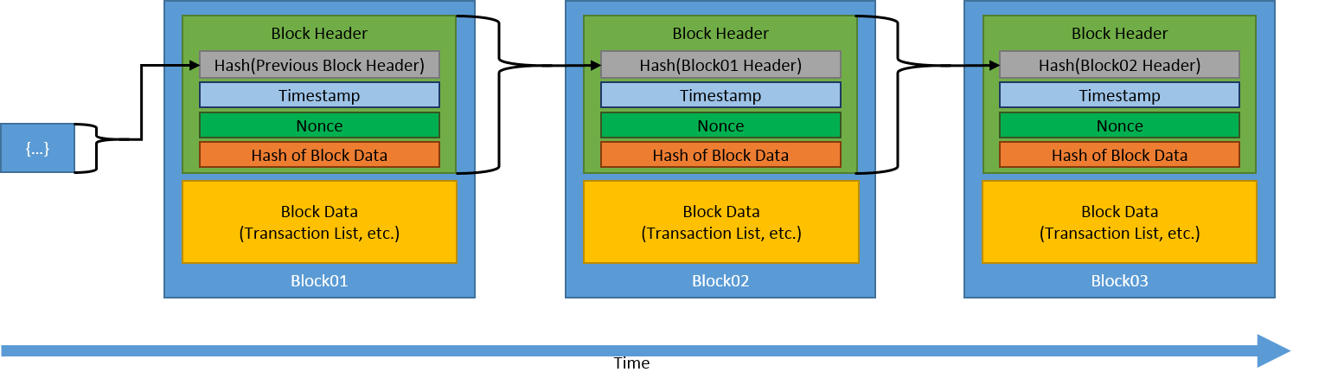
Block in Blockchain

Slide 25
Block in Blockchain
A block is actually the building block or the key element of a Blockchain.
The definition of a Blockchain is based on its blocks. A Blockchain is a chain of multiple blocks.
Blocks contain transactions. Each block contains a different number of transactions.
These transactions are contained in blocks so that they would be added to the distributed ledger.
The number of transactions is limited by the block size and gas limit. Generally, the block contains more than 500 transactions.
Other than transactions, a block also consists of some metadata. This metadata is stored in the header of the Blockchain.
The size of a block header is 80 bytes.

Slide 26
Block in Blockchain
As the blocks are linked together one after the other, they have a parent-child relationship.
Each block is the parent of the upcoming block. Each child block contains the hash of the previous block i.e., its parent block.
The first block of the Blockchain is called Genesis Block and it has no parent.
The block contains different fields which can be roughly categorized as listed below:
The block size: The size of this field is 4 bytes and it contains the size of the block.
The block header: The size of a block header is 80 bytes. It further contains different fields.
The transaction counter: This field contains the number of transactions and the size of it is between 1-9 bytes.
The transactions: This field contains transactions of the block and its size is variable.

Slide 27
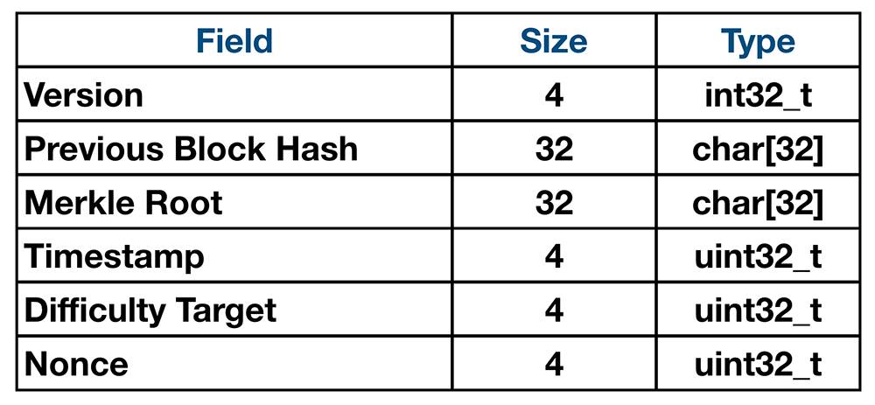
Block Header
Version: This field stores the version number to show software upgrades. The size of the version field is 4 bytes.
Hash of the previous block: Every block header gives information about the previous or parent block. This field contains the hash value of the previous block and this reference connects all the blocks. The size of this field is 32 bytes.
Merkle tree root: A Merkle tree is a structure obtained from hashing the transactional data of a block. The root of this tree is stored in the block header under this field. 32 bytes is the size of the Merkle tree root field.
Timestamp: This field contains the time at which the block was created. The size of this field is 4 bytes.
Difficulty: The mining difficulty at the time of the block creation is stored in this field. Its size is 4 bytes.
Nonce: A nonce (number only used once) is a value used during the mining of the block. This field’s size is also 4 bytes.
(Bytes)

Slide 28
Properties of Block
Difficulty Property: This property gives the difficulty level of solving the puzzle to mine the block.
TotalDifficulty Property:This property of the block tells us the total difficulty of the blockchain.
GasLimit Property: This property tells us the maximum gas allowed by the block which in turn tells us about the number of transactions that the block can accommodate.
GasUsed Property: The gasUsed property gives the amount of gas used by the block for executing all of its transactions.
Number Property: The number shows the block number in the list of blocks.
Transactions Property: This means all of the transactions contained in the block.
Hash Property: This property shows the hash of the block.
ParentHash Property: This property saves the hash of the previous block.
Nonce Property: Nonce property shows the nonce value. It is a variable used in mining the block.
Miner Property: The miner property gives information about the miner of the block. This gives the account of the block miner.

Slide 29
Types of Blockchain Architecture
Public Blockchain
Private Blockchain
Hybrid Blockchain
Consortium Blockchain

Slide 30
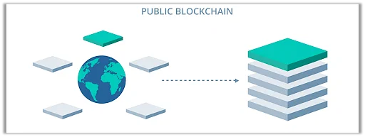
1. Public Blockchain
It is a permissionless distributed ledger on which anybody can join and conduct transactions.
It is a non-restrictive form of the ledger in which each peer has a copy. This also means that anyone with an internet connection can access the public Blockchain.
This user has access to historical and contemporary records and the ability to perform mining operations.
These complex computations must be performed to verify transactions and add them to the ledger.
On the Blockchain network, no valid record or transaction may be altered. Because the source code is usually open, anybody can check the transactions, uncover problems, and suggest fixes.

Slide 31
Advantages of Public Blockchain
Trustable: Public Blockchain nodes do not need to know or trust each other because the proof-of-work procedure ensures no fraudulent transactions.
Secure: A public network can have as many participants or nodes as it wants, making it a secure network. The higher the network's size, the more records are distributed, and the more difficult it is for hackers to hack the entire network.
Open and Transparent: The data on a public Blockchain is transparent to all member nodes. Every authorized node has a copy of the Blockchain records or digital ledger.

Slide 32
Disadvantages of Public Blockchain
Lower TPS: The number of transactions per second in a public Blockchain is extremely low. This is because it is a large network with many nodes which take time to verify a transaction and do proof-of-work.
Scalability Issues: Its transactions are processed and completed slowly. This harms scalability. Because the more we try to expand the network's size, the slower it will become.
High Energy Consumption: The proof-of-work device is expensive and requires lots of energy. Technology will undoubtedly need to develop energy-efficient consensus methods.

Slide 33
Uses of Public Blockchain
Voting: Governments can use a public blockchain to vote, ensuring openness and trust.
Fundraising: Businesses or initiatives can use the public Blockchain to improve transparency and trust.

Slide 34
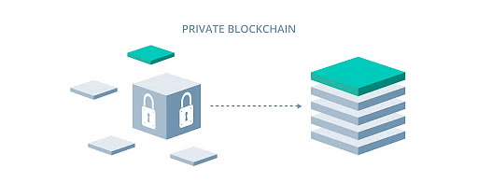
2. Private Blockchain
A Blockchain network operates in a private context, such as a restricted network, or is controlled by a single identity.
While it has a similar peer-to-peer connection and decentralization to a public Blockchain network, this Blockchain is far smaller.
They are often run on a small network within a firm or organization rather than open to anybody who wants to contribute processing power.
Permissioned Blockchain and business Blockchain are two more terms for them.

Slide 35
Advantages of Private Blockchain
Speed: Private Blockchain transactions are faster. This is because a private network has a smaller number of nodes, which shortens the time it takes to verify a transaction.
Scalability: You can tailor the size of your private Blockchain to meet your specific requirements. This makes private blockchains particularly scalable since they allow companies to easily raise or decrease their network size.

Slide 36
Disadvantages of Private Blockchain
Trust Building: In a private network, there are fewer participants than in a private network.
Lower Security: A private Blockchain network has fewer nodes or members, so it is more vulnerable to a security compromise.
Centralization: Private Blockchain are limited in that they require a central Identity and Access Management (IAM) system to function. This system provides full administrative and monitoring capabilities.

Slide 37
Uses of Private Blockchain
Supply Chain Management: A private Blockchain can be used to manage a company's supply chain.
Asset Ownership: A private Blockchain can be used to track and verify assets.
Internal Voting: Internal voting is also possible with a private Blockchain.

Slide 38
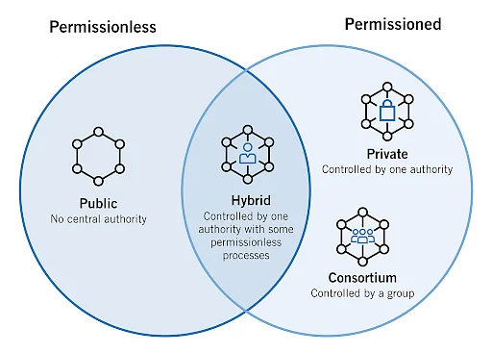
3. Hybrid Blockchain
Organizations who expect the best of both worlds use a hybrid Blockchain, which combines the features of both private and public Blockchain.
It enables enterprises to construct a private, permission-based system alongside a public, permissionless system, allowing them to choose who has access to certain Blockchain data and what data is made public.
In a hybrid Blockchain, transactions and records are typically not made public, but they can be validated if necessary by granting access via a smart contract.

Slide 39
Advantages of Hybrid Blockchain
Secure: Hybrid Blockchain operates within a closed environment, preventing outside hackers from launching a 51 percent attack on the network.
Cost-Effective: It also safeguards privacy while allowing third-party contact. Transactions are inexpensive and quick and scale better than a public Blockchain network.

Slide 40
Disadvantages of Hybrid Blockchain
Lack of Transparency: Because information can be hidden, this type of Blockchain isn't completely transparent.
Less Incentive: Upgrading can be difficult, and users have no incentive to participate in or contribute to the network.

Slide 41
Uses of Hybrid Blockchain
Real Estate: Real-estate companies can use hybrid networks to run their systems and offer information to the public.
Retail: The hybrid network can also help retailers streamline their processes.
Highly Regulated Markets: Hybrid Blockchain are also well-suited to highly regulated areas like the banking sector.

Slide 42
4. Consortium Blockchain
In the same way that a hybrid Blockchain has both private and public Blockchain features, a Consortium Blockchain, also known as a federated Blockchain, does.
However, it differs because it involves various organizational members working together on a decentralized network.
Predetermined nodes control the consensus methods in a consortium Blockchain.
It has a validator node responsible for initiating, receiving, and validating transactions. Transactions can be initiated or received by member nodes.

Slide 43
Advantages of Consortium Blockchain
Secure: A consortium Blockchain is more secure, scalable, and efficient than a public Blockchain network. It, like private and mixed Blockchain, has access controls.

Slide 44
Disadvantages of Consortium Blockchain
Lack of Transparency: The consortium blockchain has a lower degree of transparency. If a member node is infiltrated, it can still be hacked, and the Blockchain's rules can render the network inoperable.

Slide 45
Uses of Consortium Blockchain
Banking and Payments: A consortium can be formed by a group of banks working together. They have control over which nodes will validate transactions.
Research: A consortium Blockchain can be employed to share research data and outcomes.
Food Tracking: It is also apt for food tracking.

Slide 46
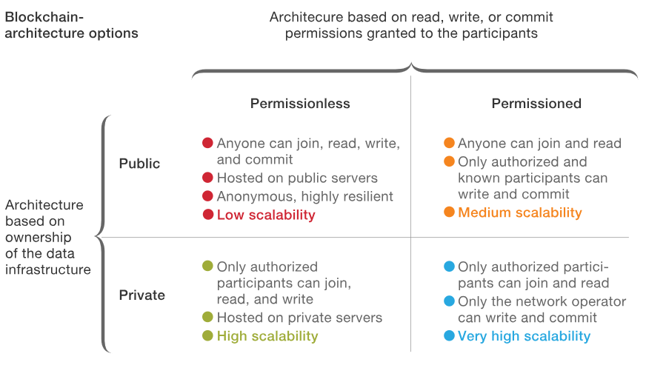

Slide 47
Mining difficulty
Every Blockchain has a mining process by which miners can generate fresh coins. An algorithm regulates how difficult it is for the miners to mine a certain block. This difficulty is known as mining difficulty.
For mining a block, a miner must solve complex mathematical problems by finding a valid hash.
As the process progresses, the network adjusts the rate so miners can find valid hashes.
Each Blockchain has its algorithm to regulate this adjustment.
The algorithm increases or decreases the mining difficulty based on the rate at which miners can mine a block.
Currently, it takes about 10 minutes to mine a Bitcoin block.
After every 2,016 blocks are mined, Bitcoin adjusts its mining difficulty.
The difficulty will increase based on the number of miners and their combined hash power.

Slide 48
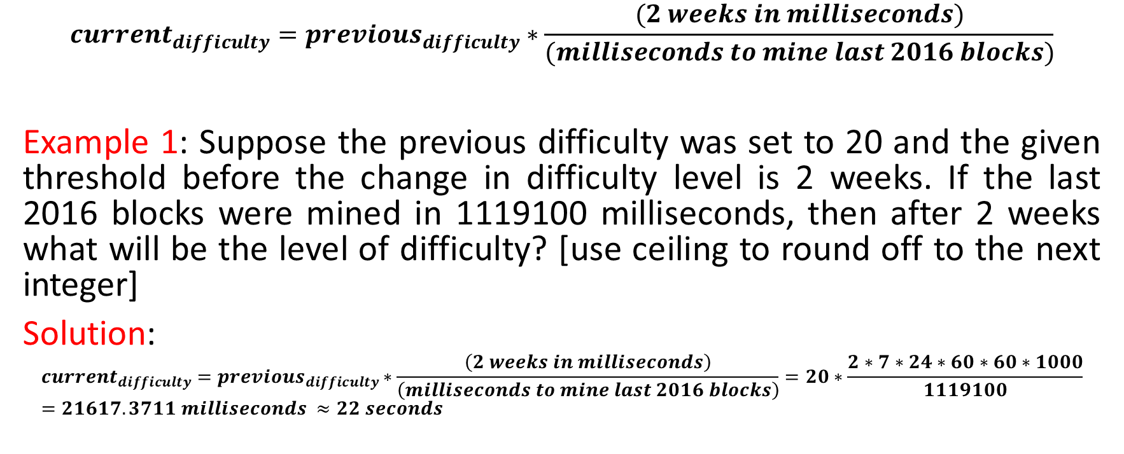
Setting the difficulty
$$current_{difficulty}=previous_{difficulty}∗\frac{(2 weeks in milliseconds)}{(milliseconds to mine last 2016 blocks)}$$
Example 1: Suppose the previous difficulty was set to 20 and the given threshold before the change in difficulty level is 2 weeks. If the last 2016 blocks were mined in 1119100 milliseconds, then after 2 weeks what will be the level of difficulty? [use ceiling to round off to the next integer]
Solution:
$$current_{difficulty}=previous_{difficulty}∗\frac{\left(2 weeks in milliseconds\right)}{\left(milliseconds to mine last 2016 blocks\right)}=20∗\frac{2∗7∗24∗60∗60∗1000}{1119100}=21617.3711 milliseconds ≈22 seconds$$

Slide 49
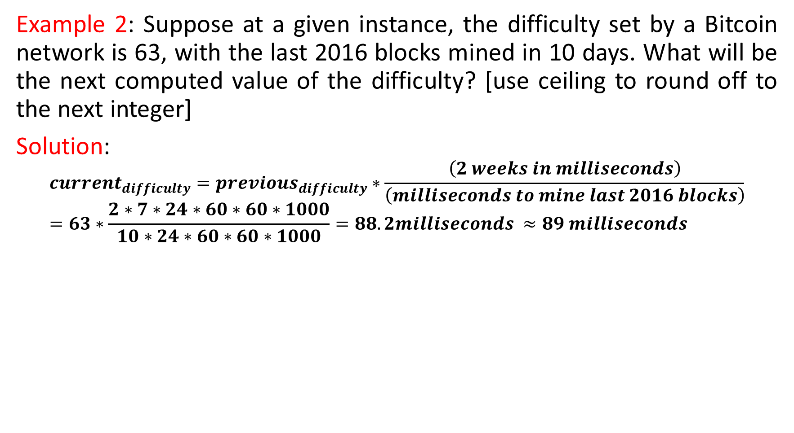
Example 2: Suppose at a given instance, the difficulty set by a Bitcoin network is 63, with the last 2016 blocks mined in 10 days. What will be the next computed value of the difficulty? [use ceiling to round off to the next integer]
Solution:
$$current_{difficulty}=previous_{difficulty}∗\frac{\left(2 weeks in milliseconds\right)}{\left(milliseconds to mine last 2016 blocks\right)}=63∗\frac{2∗7∗24∗60∗60∗1000}{10∗24∗60∗60∗1000}=88.2milliseconds ≈89 milliseconds$$

Slide 50
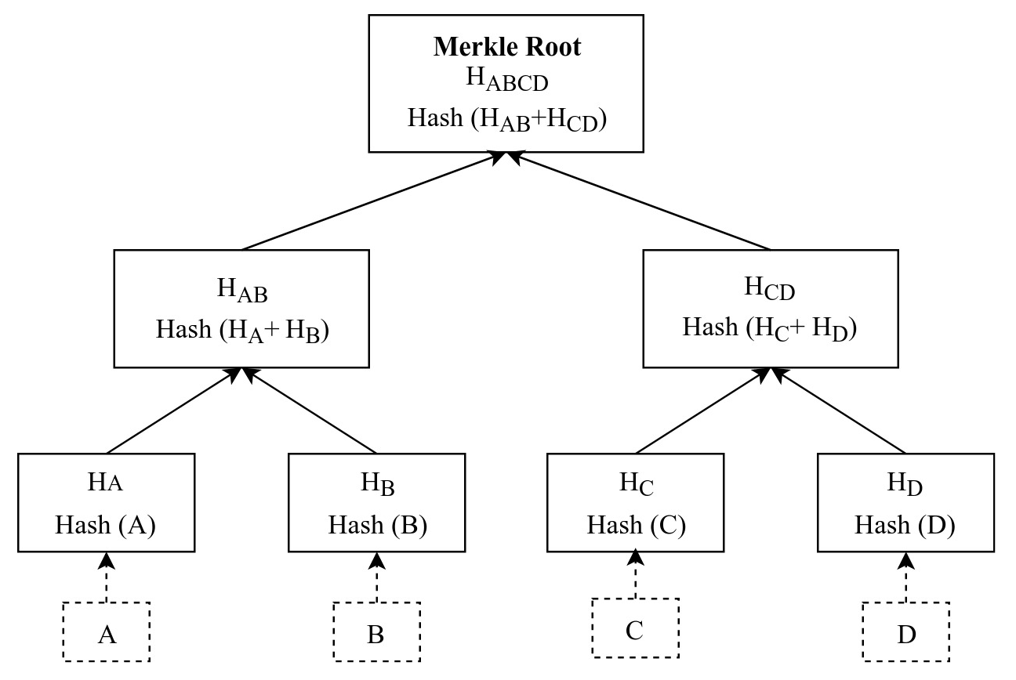
Merkle tree
A Merkle tree is a binary tree where all the leaf nodes represent hashes of the data blocks.
Each parent node has the hashed value of the hashes of its children.
Hashing continues until the root node of the tree.

Slide 51
Benefits of Merkle Tree in Blockchain
Merkle trees provide four significant advantages -
Validate the data's integrity: It can be used to validate the data's integrity effectively.
Takes little disk space: Compared to other data structures, the Merkle tree takes up very little disk space.
Tiny information across networks: Merkle trees can be broken down into small pieces of data for verification.
Efficient Verification: The data format is efficient, and verifying the data's integrity takes only a few moments.

Slide 52
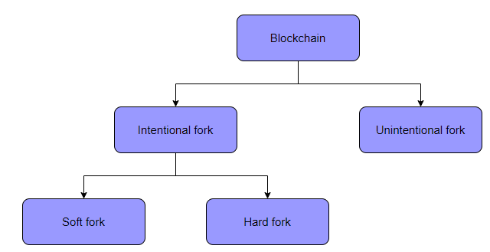
Fork in Blockchain
Forks represent an upgrade to the Blockchain’s underlying protocols initiated by the Blockchain community.
Forks divide the Blockchain into two chains. Sometimes, the two chains are compatible, resulting in a soft fork.
Other times, the changes in the protocols are so significant that the two chains are not compatible anymore, resulting in a hard fork.
Hard forks and soft forks are intentional forks. However, there is another type of fork called accidental or natural fork. This happens when two miners mine a block simultaneously, and both are deemed valid by the validators.

Slide 53
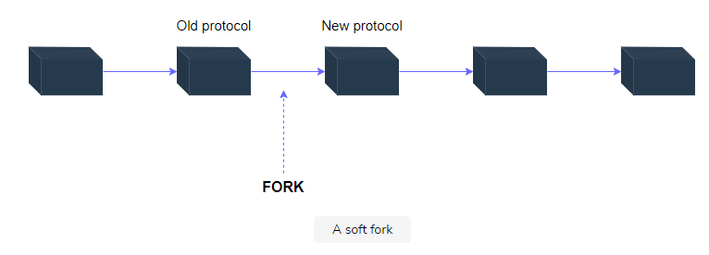
Soft Fork
A soft fork is considered to be the most reasonable of the two.
It is an intentional fork usually used to update the protocols slightly while ensuring that the new protocol remains backward compatible with blocks formed prior to the fork.
This means that updating the new protocol is optional for nodes, resulting in only one chain.

Slide 54
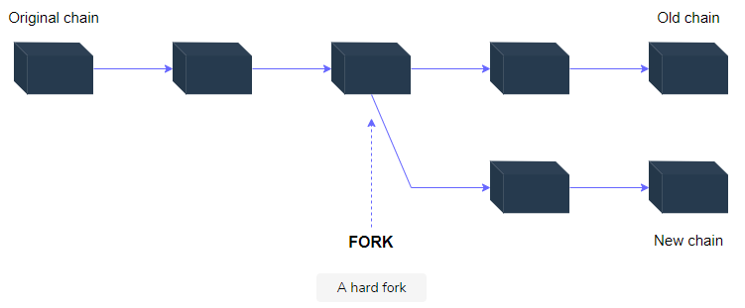
Hard Fork
The hard fork is usually an intentional fork resulting in the chains being incompatible.
The chains continue following different paths from the point of the fork.
One chain follows the new protocol, while the other continues to follow the old protocols.
Hard forks have been used previously to add functionalities, improve the network’s speed, and decrease gas fees.

Slide 55
Hard Fork Vs Soft Fork
Characteristics | Hard Forks | Soft Forks
Authority level | They often make a change to the original protocol, thus requiring a stronger consensus of nodes and miners | It is backward-compatible, so attackers can reinstate earlier models by manipulating the nodes.
Split in the chain | The original chain splits into two. | There is no splitting as the original chain moves forward with minor upgrades.
Need for upgradation | All the users on the network need to agree to the new chain in order to use it. | Only the ones that have the use of upgrades need to upgrade their network.
Vulnerability | It is not backward compatible. Hence hackers can take the majority consensus by manipulation and create a hard fork. | It is backward-compatible, so attackers can reinstate earlier model by manipulating the nodes.
Power Requirements | Hard forks require high computational power since a new side chain generates out of the original one. | Generally, 51% hash power is required for a soft fork.

Slide 56
What is Consensus?
Consensus means achieving a state of a decision on which all network participants agree. For example, a group of friends decides on a trip to Goa without conflicts. Here, reaching a decision to visit Goa together is a state of consensus or mutual agreement.
However, getting a no-conflict decision agreement by each person in a group seems far-fetched. Maybe someone wants to go to Manali instead. How could a group of friends possibly reach a consensus? Moreover, how can numerous strangers achieve consensus in a network?
In order to avoid centralization and conflicts among members, the system requires a consensus mechanism or algorithm.

Slide 57
What is Consensus Mechanism?
A consensus algorithm is a way to keep network members synchronized under democracy. With decentralization, each network member has equal power to make decisions in the system. Hence, rules need to be established for network members (or nodes) to implement new changes to the system with a global agreement.
“The purpose of the Consensus mechanism in a decentralized network is to allow a group of independent nodes to distribute the right to update as well as validate the change in the network equally. Therefore, decide on the next update of a decentralized network.”
In a blockchain, each participant shares the exact same copy of the network transactions, which helps them stay synchronized and connected.

Slide 58
How Does Consensus Work?
There are a number of consensus mechanisms to operate on a decentralized network. Each algorithm has its own way of reaching a global agreement on a network update.
Generally, consensus protocols form at least 51% of participants in the network to agree on the upcoming change.
If they agree, the network system gets updated with the new change. Otherwise, it rejects the change by mutual agreement.

Slide 59
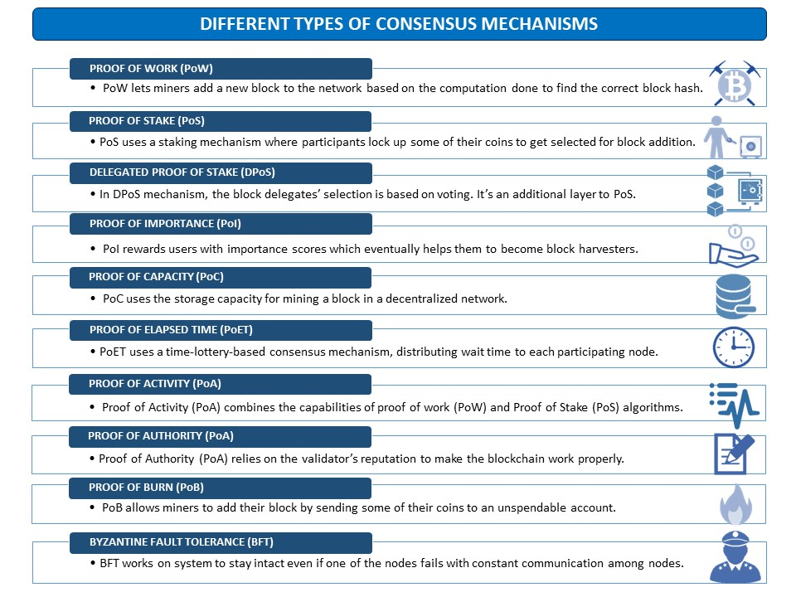
Types of Consensus Mechanisms

Slide 60
Proof of Work (PoW)
PoW is a popular consensus algorithm used by Bitcoin and Ethereum networks. Here, miners (or block adders) have to do heavy mathematical computations to find a right hash by changing the nonce of the block. The miner who finds the hash below the difficulty level gets the chance to add his block to the network. Hence, takes the reward.
It’s a puzzle-friendly way to reach consensus by using high computational power. Afterward, already present network participants valid transactions in the block added by the miner.
Blockchains using PoW algorithm: Bitcoin, Ethereum, Dogecoin, Litecoin, Zcash, Horizon, and many more.

Slide 61
Proof of Stake (PoS)
PoS consensus eliminates the high energy consumption by PoW. PoS uses a staking mechanism in which miners (or validators) hold some of their earned coins in the network to get selected for adding a block.
It’s not an initial consensus algorithm for a network. It can only be implemented after a network gets a good amount of participants (or nodes).
Blockchains using PoS algorithm: Polkadot, EOSIO, Cardano, Ethereum 2.0, and many more.

Slide 62
Delegated Proof of Stake (DPoS)
DPoS improves the PoS mechanism by introducing voting for delegates.
Here, network participants vote for the trusted delegates (or miners) using their coins.
Then, based on a random selection, one voted delegate gets the chance to add its block.
Blockchains using the DPoS algorithm: EOS, Lisk, Ark y Tron

Slide 63
Proof of Importance (PoI)
PoI uses importance scores to select the one block harvester out of all participants.
It aims to eliminate favors toward rich stakeholders in PoS consensus.
The importance score depends on your quality transactions and reputation in the network.
Blockchain using PoI algorithm: New Economy Movement (NEM)

Slide 64
Proof of Capacity (PoC)
PoC uses the disk or storage capacity for mining a block in a decentralized network.
It exchanges the computation factor with disk space.
The PoC motivates miners to collect a list of all the possible nonce and block hashes before the actual mining.
At the time, the miner just uploads the calculated files of possible hashes to the network. PoC reduces the time taken to add and validate the block of transactions.
Blockchains using PoC algorithm: Burstcoin, Storj, Chia, and SpaceMint.

Slide 65
Proof of Elapsed Time (PoET)
PoET mechanism uses time-lottery-based concepts.
It distributes random waiting times to each miner.
For that waiting time the miner node sleeps, and the first woken up node (or short waiting time node) gets the chance to add its block to the network.
Afterward, the block verification takes place by network validators, and a new block gets added.
Blockchain using PoET algorithm: Hyperledger Sawtooth

Slide 66
Proof of Activity (PoA)
Proof of Activity (PoA) combines PoW and PoS mechanisms.
First, the miners must do the heavy computation to add an empty block with header information and reward address.
Afterward, one empty block gets chosen based on the number of coins they hold in their respective accounts.
Then, the miner of that empty block gets the chance to add its transactions to the block.
Moreover, the transactions are verified by network validators.

Slide 67
Proof of Authority (PoA)
Proof of Authority (PoA) consensus utilizes by private or permissioned blockchain networks.
PoA highly depends on the reputation of the miner or the network participant who wishes to add a new block of transactions.
Here, miners stake their reputation instead of coins.
Blockchain using PoA algorithm: VeChain

Slide 68
Proof of Burn (PoB)
PoB allows miners to add their block by sending some of their coins to an unspendable account.
This process of sending your earned coins to an escrow account is called burning the coins.
PoB eliminated the burnt coins permanently from regular transactions. Hence, they become unspendable even by its owner.
The more coins a miner burns, the higher his chances of adding his new block of transactions to the network. Burning coins brings virtual mining rights to the miner.
Blockchain using PoB algorithm: Slimcoin

Slide 69
Byzantine Fault Tolerance (BFT)
BFT aims to resolve Byzantine Generals’ decisional puzzle.
It’s based on the communication problem that generals of different armies might have to decide to attack or retreat at the same time.
BFT mechanism regulates the communication between nodes using hashes, digital signatures, and metadata. It embraces the synchronization among nodes of a decentralized network.
Blockchains using BFT algorithm: Hyperledger Fabric and Zilliqa

Slide 70
Pros and Cons of Consensus Mechanisms
PROS | CONS
– Establishing global agreement in a distributed network. – Create protection and security against intruder attacks. – Mechanisms are available for both permission and permissionless blockchain networks. | – Few of the mechanisms consume high power and energy, leading to environmental hazards. – Some of the mechanisms are susceptible to 51% attacks and Sybil attacks. – The constant fear of turning a decentralized network into a centralized one.

